Slide 1
Physics 201
Winter 2013
Celestial mechanics

Slide 2
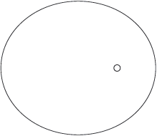
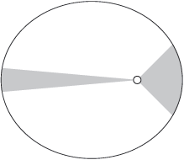
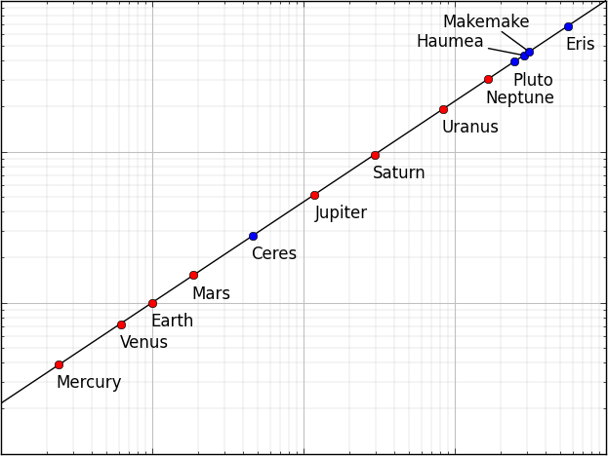
Kepler’s three laws of planetary motion
Winter 2013
The orbit of every planet is an ellipse with the Sun at one of the foci
A line joining a planet and the Sun sweeps out equal areas during equal intervals of time
The square of the orbital period is proportional to the cube of the orbital size

Slide 3

Newton’s triumph was to derive the laws of Kepler
Winter 2013
These laws all follow from
The first law is the most difficult to show – we will not attempt to do so
But the first law tells us that the natural motion of objects in the solar system is along elliptical paths
Therefore, we must learn a few facts about ellipses in order to move on…

Slide 4
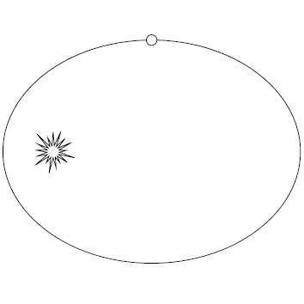
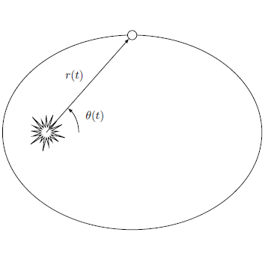
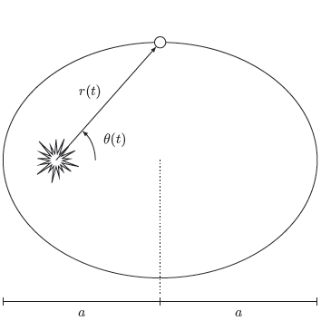
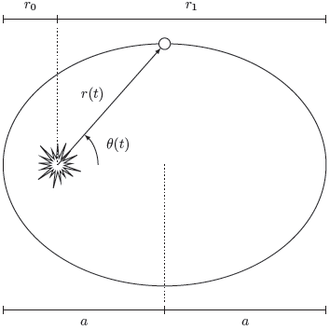





What you must know about ellipses – and nothing more
Winter 2013
Orbital
parameters
Eccentricity
Perihelion
Aphelion
Focus
Center
Orbital period
Geometric
parameters
Show me

Slide 5
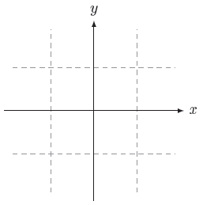
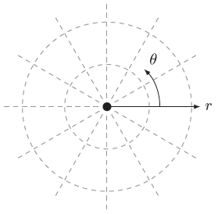
Special coordinate systems exploit system symmetries
Winter 2013
Cartesian coordinates
Polar coordinates

Slide 6
Multiple math conventions compete in astrodynamics
Winter 2013
Cartesian
Polar
Geometric
Orbital
Dynamic

Slide 7
Three analytical techniques available
Newton’s
laws
Advantage: Works every time
Disadvantage: Blind to trajectory
Energy and
momentum
Advantage: Exact and simple
Disadvantage: Patchwork solutions only
Principle of least action
Advantage: Targeting possible
Disadvantage: Computationally difficult
Show me

Slide 8
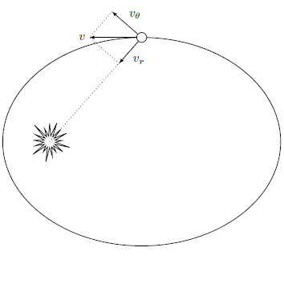
Polar components of energy lead to “effective potential”
Winter 2013
Kinetic energy
“Effective potential”

Slide 9
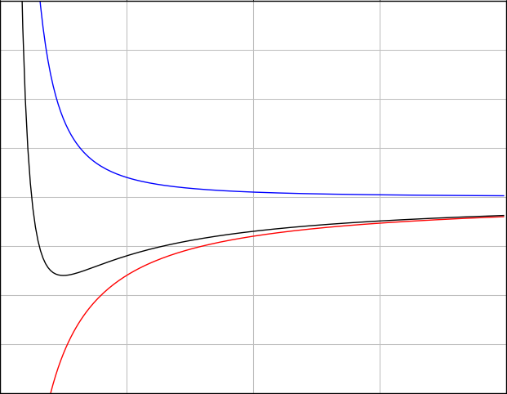


Using the effective potential makes this a 1D problem
Winter 2013
Energy level of planet
Perihelion
Aphelion
The trajectory of the particle does not depend on its mass – to make things a bit
simpler, both energy and angular momentum will be implicitly divided by mass.
Show me

Slide 10
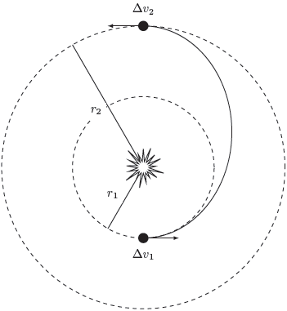

The Hohmann transfer orbit
Winter 2013
Two bursts: at perigee another at apogee
Longest time of transit
Minimum Δv budget
Show me

Slide 11
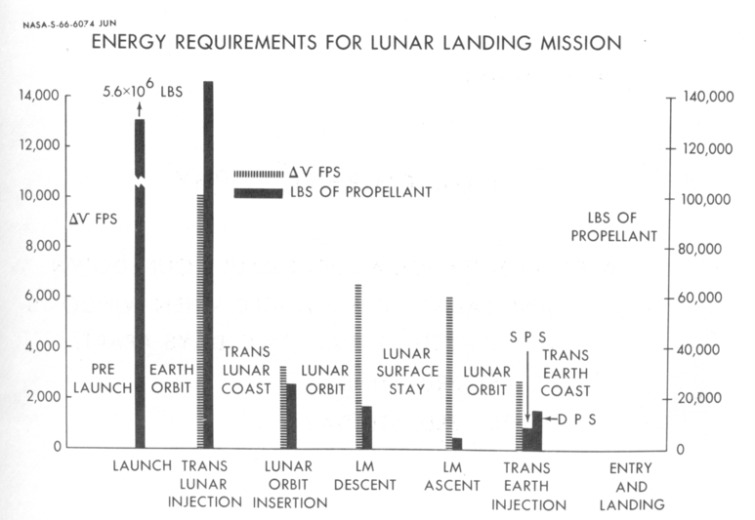
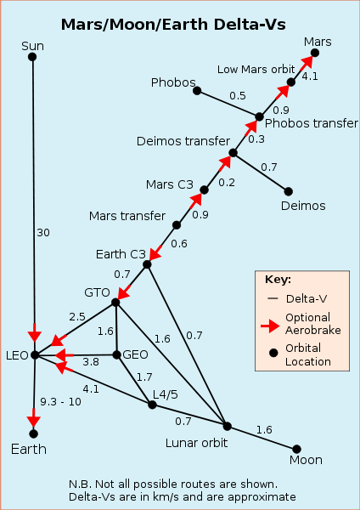
Planning a trip in space?
Manage your Δv budget
Winter 2013
Source: http://en.wikipedia.org/wiki/Delta-v_budget

Slide 12

Gravitational slingshot can be a huge source of Δv
Winter 2013
This is an elastic “collision” – in the CM frame, the ingoing and outgoing speeds are the same
Since the planet is so massive, the center of mass essentially follows the planet
The probe rebounds off the planet like a baseball off a bat
Maximum Δv is twice the speed of the planet
Source: http://en.wikipedia.org/wiki/Gravitational_slingshot

Slide 13
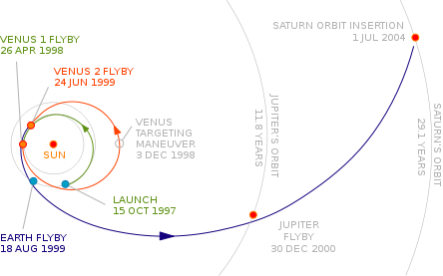
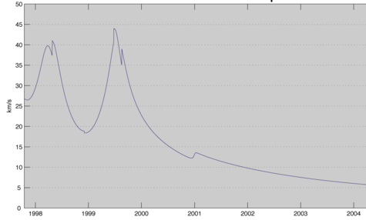
Slingshot example: Cassini
Winter 2013
Venus 1
Flyby
Venus 2
Flyby
Earth
Flyby
Jupiter
Flyby
Targeting
Maneuver
Source: http://en.wikipedia.org/wiki/Cassini-Huygens

Slide 14
Beyond Kepler
Winter 2013
Perturbation
Any small deviation from inverse square law cause elliptical orbit to rotate slightly.
Mars cycler
Orbital solution between Earth and Mars originally proposed by Buzz Aldrin [video].
Interplanetary transport network
Uses unstable Lagrange points to shift orbit with little energy. Technique used to rescue a lunar mission from Japan.
Source: http://en.wikipedia.org/wiki/Interplanetary_transport_network

Slide 15
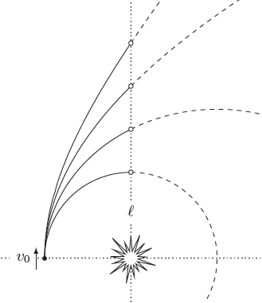

Escape velocity and unbound orbits
Winter 2013
Semi-latus
rectum
Added speed increases energy and makes the orbit more linear
If total energy is positive, the orbit will not return
Escape velocity is the break-even speed
No return
Escape orbit
Elliptical orbit
Circular orbit

Slide 16
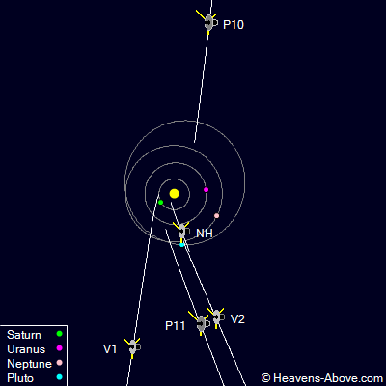
Machines that will never come back
Winter 2013
 | Launch date | Distance (AU) | Speed (AU/yr) | Working?
Pioneer 10 | Mar 1972 | 107 | 2.54 | no
Pioneer 11 | Apr 1973 | 86.8 | 2.40 | no
Voyager 2 | Aug 1977 | 100 | 3.26 | yes
Voyager 1 | Sep 1977 | 122 | 3.60 | yes
New Horizons | Jan 2006 | 24.8 | 3.21 | yes
Source: http://www.heavens-above.com/

Slide 17
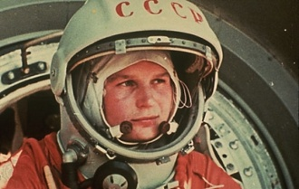

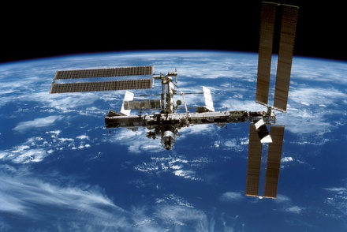
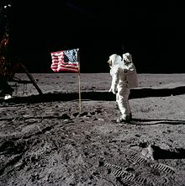
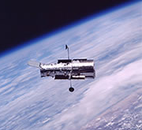

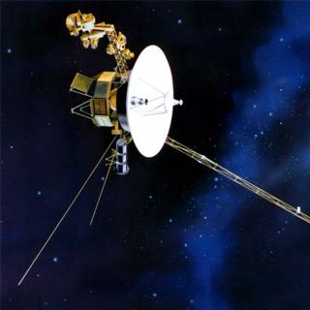
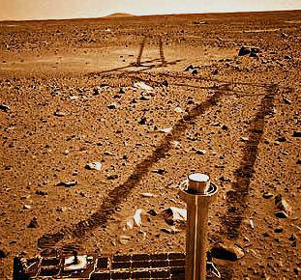
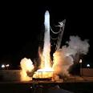
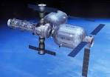
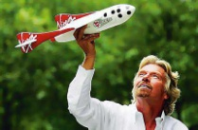
Is there a future in space?
Winter 2013
Phase 1 : 1950 – 1980
“The Glory Days”
Phase 2 : 1980 – 2010
“No Nonsense”
Phase 3 : 2010 – 2040
“Divide & Conquer”

